Slide 1
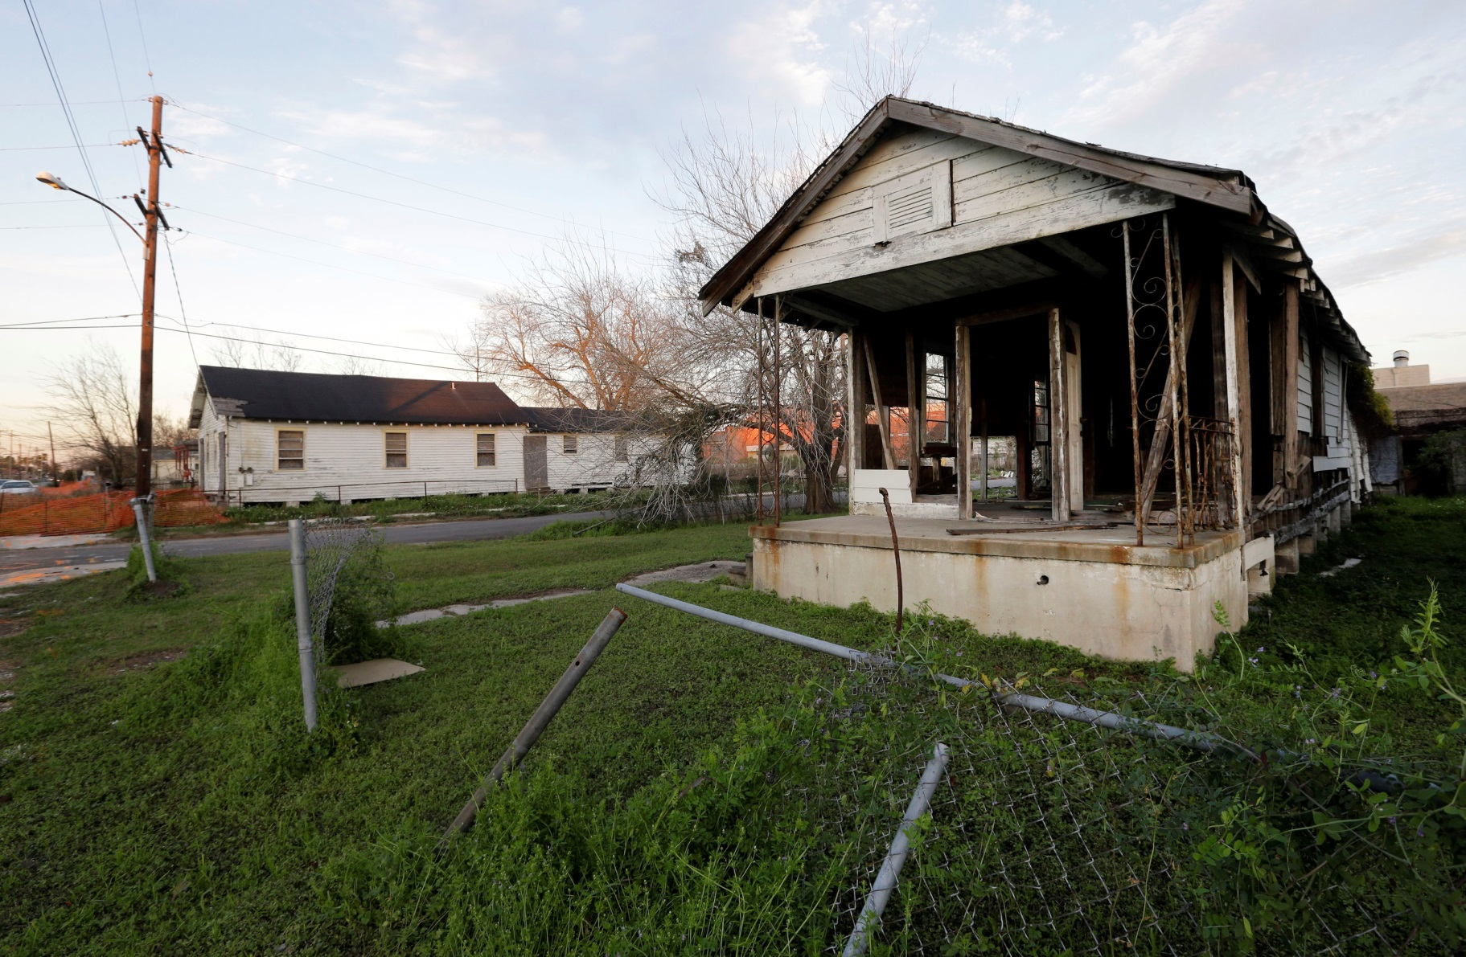
Theo Watson
-Ricky Hudson

Slide 2
The Storm
Theo Watson was younger at the time of the storm, probably around 15-18 years old. He and his family managed to escape the storm, but when they returned there wasn’t anything left. His whole home he grew up in was washed away and destroyed. The only thing he has left to remember his old home by is a single white picket from his fence.

Slide 3
Return Home
He wants to return home with his father until the father’s home is rebuilt. There were some issues with that. The property was under his mother’s name, but she passed away prior to the storm, leaving his father a partial owner. They had to get his brother’s and a lawyer to sign off the property to his father before they could start anything. Once they did sign it off, the mortgage on the property had to be payed off. It took 5 years before they started any sort of rebuilding.

Slide 4
Rebuilding!
Theo and his father payed off the mortgage and bean to invest into the fathers new home. The troubles didn't stop there unfortunately. They needed to pay off the lawyer that helped them prove they owned the property. By the time they started rebuilding, most of their investments were used up. By the time they ran out, they only had a layout for the father’s house. So now they are both crammed in an apartment elsewhere in New Orleans.

Slide 5
Recovery
I chose this client because I want Theo to have a home to live in, and I want his fathers home to be rebuilt while he can stay in comfort. They have been trying their best to make it back home but haven't been able to succeed. I want to be able to help them make it.

