Slide 1
CHARLES KING AND HIS FAMILY

Slide 2
The Story

Slide 3
The Kings
Charles king and his family have been lived in New Orleans, until Katrina struck. Like thousands of other people the Kings took shelter in Houston, TX. They took shelter in the Astrodome, and spent time in there until they could get a real place. They soon found an apartment, but two months after they moved into a building paid for by government vouchers. After the storm passed Charles needed to make a living. He thought the best place to do that was back in New Orleans, so he left his wife and 14 year old son to find work back in New Orleans in hopes of bringing his family back home.

Slide 4
Katrinas Destruction
On August 29th, 2005 hurricane Katrina struck the gulf coast of the United States. When the storm hit New Orleans the damage was massive, but not as bad as what came after the storm. Because of bad engineering the storm broke the levees keeping the water out of the city, thus causing the whole city to flood. After the storm was over there were billions of dollars in damage and hundreds dead.

Slide 5
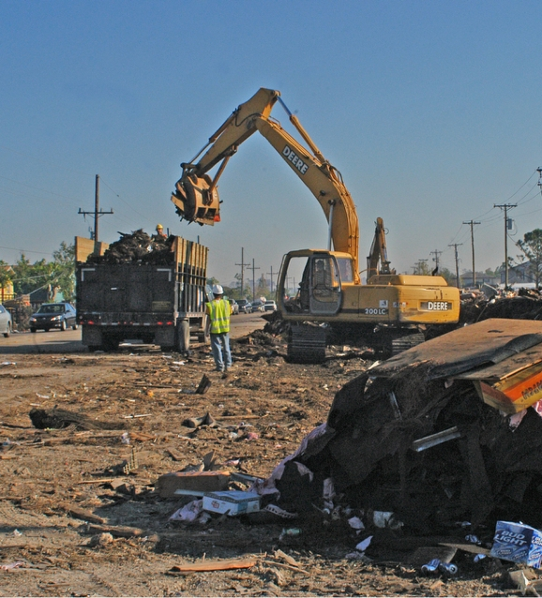
Back in New Orleans
When charles got home he struggled trying to find work like all the other now homeless people. Eventually Charles found work driving dump trucks and cleaning up wreckage from the storm.
“It was definitely a struggle. I found a couple of little odd jobs driving trucks, but not much,” King says. “I just wanted to get back home.”

Slide 6
Reunited
In August of 2006 Charles’ son and wife moved back out to New Orleans in hopes of restarting their life back at home.

Slide 7
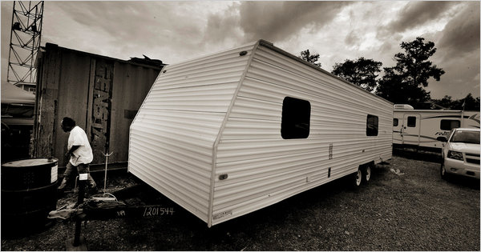
In Limbo

Slide 8
Five years after the storm the King family was one of hundreds of families living in FEMA trailers. For years the King family lived in the emergency trailers, and couldn't get a home. It’s my goal to design the new home that this family will be living in.

